Slide 1

Multiplayer Turn-Based Game Engine using Java
Name: Subham Pal
Roll no.: 82
Problem:
Lack of reusable architecture in turn-based games
Target User:
Students and beginner developers

Slide 2
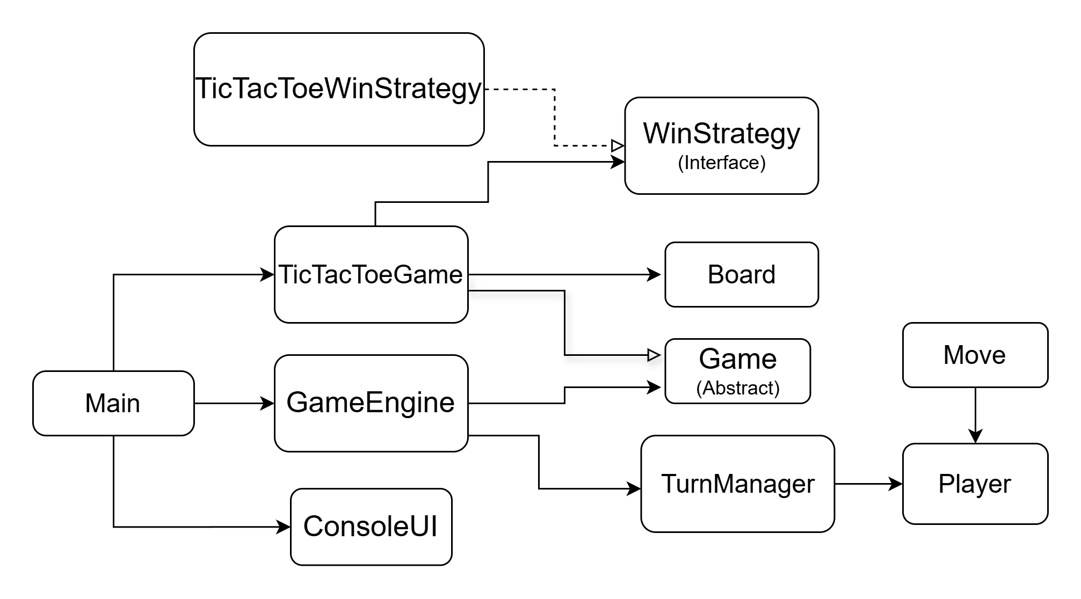
System Design
Architecture:
UI → Engine → Game → Strategy → Model
Key Classes:
Game
TicTacToeGame
GameEngine
TurnManager
Player
Packages:
app, engine, model, games, strategy, ui

Slide 3
OOP Concepts Used
Abstraction → Game abstract class
Inheritance → TicTacToeGame extends Game
Polymorphism → Overridden methods (checkWinner)
Encapsulation → Player class (private data)
Design Pattern → Strategy Pattern (winner logic)

Slide 4
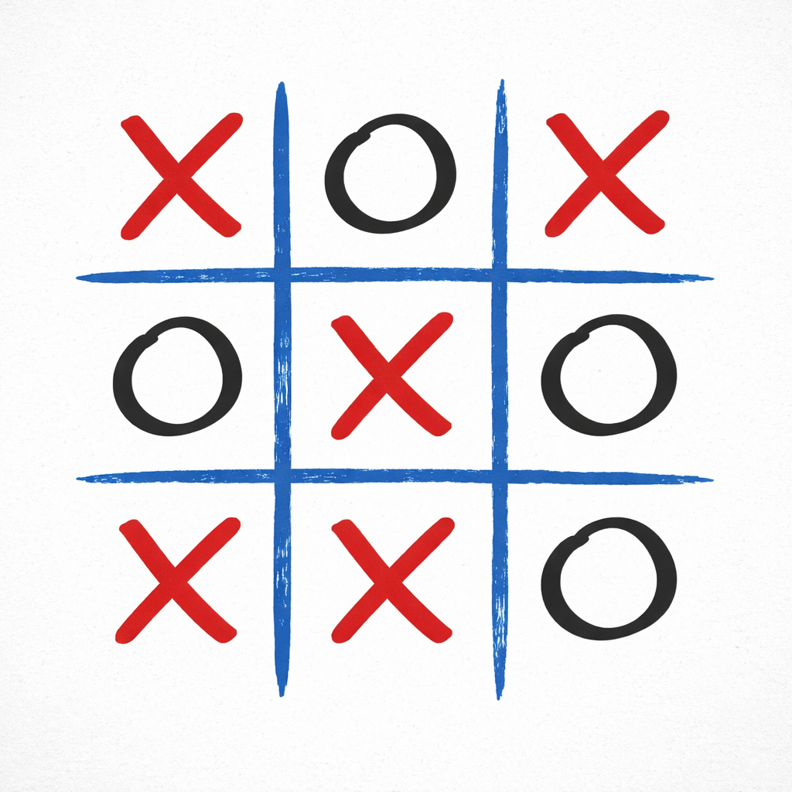
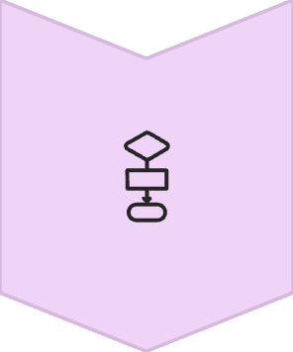

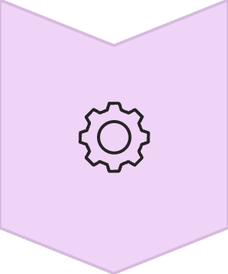
TECHNICAL HIGHLIGHT
Strategy Pattern
Used for winner detection logic
Separates game rules from engine
Allows easy addition of new games

Slide 5
Live Demo
Game execution
• Valid move
• Invalid move (error handling)
• Winner detection
• Draw condition

